Slide 1
Big Compute
Notes:
Information in this document, including URL and other Internet Web site references, is subject to change without notice. Unless otherwise noted, the example companies, organizations, products, domain names, e-mail addresses, logos, people, places, and events depicted herein are fictitious, and no association with any real company, organization, product, domain name, e-mail address, logo, person, place or event is intended or should be inferred. Complying with all applicable copyright laws is the responsibility of the user. Without limiting the rights under copyright, no part of this document may be reproduced, stored in or introduced into a retrieval system, or transmitted in any form or by any means (electronic, mechanical, photocopying, recording, or otherwise), or for any purpose, without the express written permission of Microsoft Corporation.
Microsoft may have patents, patent applications, trademarks, copyrights, or other intellectual property rights covering subject matter in this document. Except as expressly provided in any written license agreement from Microsoft, the furnishing of this document does not give you any license to these patents, trademarks, copyrights, or other intellectual property.
The names of manufacturers, products, or URLs are provided for informational purposes only and Microsoft makes no representations and warranties, either expressed, implied, or statutory, regarding these manufacturers or the use of the products with any Microsoft technologies. The inclusion of a manufacturer or product does not imply endorsement of Microsoft of the manufacturer or product. Links may be provided to third party sites. Such sites are not under the control of Microsoft and Microsoft is not responsible for the contents of any linked site or any link contained in a linked site, or any changes or updates to such sites. Microsoft is not responsible for webcasting or any other form of transmission received from any linked site. Microsoft is providing these links to you only as a convenience, and the inclusion of any link does not imply endorsement of Microsoft of the site or the products contained therein.
© 2017 Microsoft Corporation. All rights reserved.
Microsoft and the trademarks listed at https://www.microsoft.com/en-us/legal/intellectualproperty/Trademarks/Usage/General.aspx are trademarks of the Microsoft group of companies. All other trademarks are property of their respective owners.

Slide 2

Abstract and learning objectives
Abstract
Setup and configure a scale-out media processing architecture using Azure Batch. You will use big compute (scale-out compute, embarrassingly parallel processing) techniques without having to write a lot of code, learning how these tasks can be accomplished declaratively.
Learning objectives
Learn the core capabilities of Azure Batch
Understand how to author custom Pool and Job templates
Work with Job input and output files
Learn to author Batch auto-scale formulas
Leverage Batch Explorer and the Azure Portal for management and monitoring
Use Marketplace applications to simplify common big compute tasks, such as 3D rendering

Slide 3
Step 1: Review the customer case study
Outcome
Analyze your customer needs
Timeframe
15 minutes

Slide 4
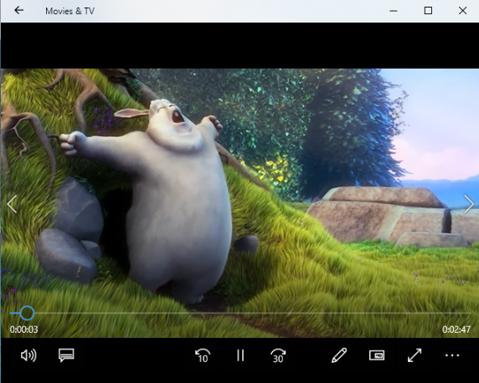
Customer situation
ThoughtRender provides image and video processing services to many industries – marketing and advertising, retail, medical, and media and entertainment
Facing challenges from their success in terms of their growth, and ability to scale to new jobs, and new industries
(c) copyright 2008, Blender Foundation / www.bigbuckbunny.org

Slide 5
Customer situation
Curious about cloud and think that not only could it help them scale, improve costs and pass savings to customers, and to take advantage of new technologies, such as the latest GPUs
Would like to answer their customers who often asks questions like, “Could you get that job processed this week, instead of in 3 weeks’ time?”
Are considering bursting jobs to the cloud in a pilot to address this

Slide 6
Customer situation
Currently operate their own, on-premises services and have three large on-premises HPC clusters – one in each site – London, New York, and Singapore
Have labs in each site that provide high-end visualization workstations for quality control
Have 3 Petabytes (PB) of data (customer assets, and working “scratch” data shares) – about 1 PB stored per site

Slide 7
Customer needs
ThoughtRender wants to:
Provide better flexibility to their customer demands (i.e., to have more work processed, or to complete work in a faster time)
Investigate potential advantages to using the cloud (e.g., latest technologies, bursting capability, cost savings)
Integrate with their on-premises systems where possible (e.g., to burst to cloud for additional capacity)
Collaborate and visualize the results of their work, on their own, or together with customers

Slide 8
Customer objections
Will Azure give us control to schedule jobs when we want?
Will the capacity be available when we want it?
We heard Microsoft does Linux now. But how true is this? Will it work with our chosen Linux version?
We have Petabytes of data on-premises. It would cost us a fortune and take ages to move this to the cloud!
We heard collaboration is possible for 3D imaging workstations, but we are concerned that this may not be possible in the cloud.
Will this take jobs away from our IT system administrators and HPC engineers?

Slide 9
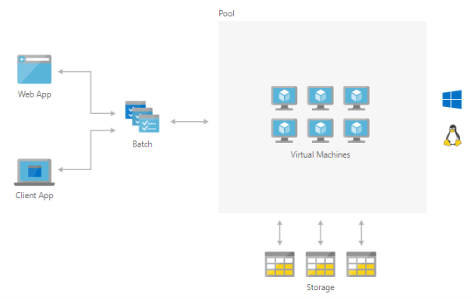
Common scenarios
https://azure.microsoft.com/en-us/solutions/architecture/hpc-big-compute-saas/

Slide 10
Step 2: Design the solution
Outcome
Design a solution and prepare to present the solution to the target customer audience in a 15-minute chalk-talk format.
Timeframe
60 minutes
Business needs (10 minutes) | Respond to questions outlined in your guide and list the answers on a flipchart.
Design (35 minutes) | Design a solution for as many of the stated requirements as time allows. Show the solution on a flipchart.
Prepare (15 minutes) | Identify any customer needs that are not addressed with the proposed solution. Identify the benefits of your solution. Determine how you will respond to the customer’s objections. Prepare for a 15-minute presentation to the customer.

Slide 11
Step 3: Present the solution
Outcome
Present a solution to the target customer in a 15-minute chalk-talk format.
Timeframe
30 minutes (15 minutes for each team to present and receive feedback)
Directions
Pair with another table
One table is the Microsoft team, and the other table is the customer
The Microsoft team presents their proposed solution to the customer
The customer asks one of the objections from the list of objections in the case study
The Microsoft team responds to the objection
The customer team gives feedback to the Microsoft team

Slide 12
Wrap-up
Outcome
Identify the preferred solution for the case study
Identify solutions designed by other teams
Timeframe
15 minutes

Slide 13

Preferred target audience
Thomas Pix, CIO of ThoughtRender
The primary audience is business decision makers and technology decision makers
Usually, we talk to the Infrastructure Managers who report to the CIOs, or to application sponsors (like a VP LOB, CMO) or to those that represent the Business Unit IT or engineers who report to the application sponsors

Slide 14
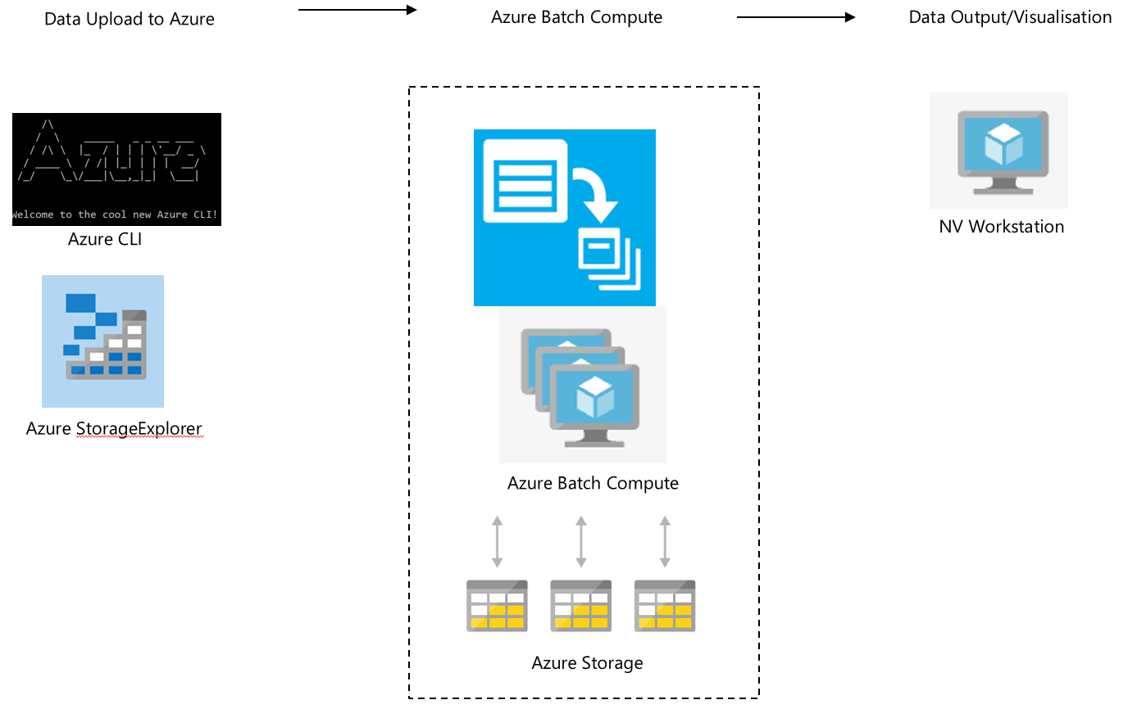
Preferred solution
High Level Architecture
ThoughtRender decided that Azure would, in fact, be the right choice for their platform.
They decided to load data into blob storage
Explore and prepare it using Storage Explorer and Azure CLI
Execute their compute workload with Azure Batch
Consider integrations with existing tools and apps their rendering users already have
Visualize and collaborate on remote workstations using Azure NV compute instances, with optional software from third-party providers

Slide 15

Preferred solution
Data Loading
How would you recommend that ThoughtRender get their data into (and out of) Azure?
Consider using the Microsoft Azure Import/Export service, or the Azure Data Box
Data will be loaded on-premises at ThoughtRender to hard drives provided by either service
These hard drives will then be sent to chosen/agreed Microsoft Azure datacenters, and data loaded directly to the customer’s Azure tenant, typically into a Blob storage account
No special preparation of the data may be required, other than whatever file structure may facilitate the customer’s workflow easiest in Azure (e.g., input and output folders)

Slide 16
Preferred solution
Video and Image Processing
What software tools can they use?
They should continue to use what they are using on-premises
Azure Batch provides various levels of integration and support may be available with Azure for their applications - need to assess on an app by app basis
Combination of both Open Source and commercial tools
Open Source tools used for image/video processing include FFmpeg and Blender
Commercial software tools used in rendering may include 3ds Max, Maya, RedShift
Open Source tools (Linux or Windows based) are welcome and usable on Azure
For Linux based tools, does it matter which flavor of Linux is chosen?
Typically, yes
Always check the flavor/distribution and version of Linux that is being used to support the applications (e.g., CentOS, version 7.2)

Slide 17
Preferred solution
Video and Image Processing
When are these tools used at ThoughtRender? Are they part of a workflow?
Typically all of these software tools are used as part of a “workflow” at the company
It is important to know at which part of the workflow the tool is used, and how this may fit with other applications

Slide 18
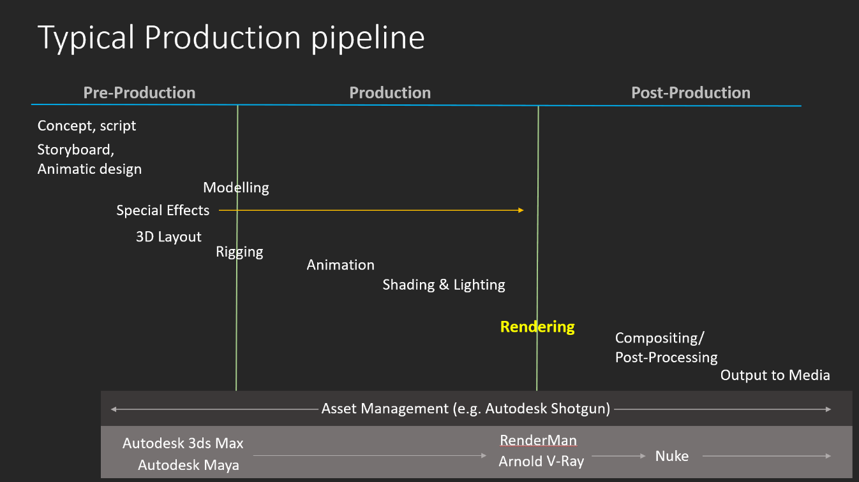
Preferred solution

Slide 19
Preferred solution
Batch Computing
What technology would you recommend that ThoughtRender use for implementing their rendering compute workloads in Azure?
Azure Batch Rendering service
Are there particular types of compute instances you would guide ThoughtRender to use?
Rendering is a compute-heavy activity with a requirement for fast storage to read/write resources (e.g., image maps) and individual frames of video as the rendering activity works through a sequence of video
Frames typically render independently so no need for node inter-communication (i.e., Infiniband) during the render
Compute-intensive instances (e.g., H16, A9) are needed. Fast SSD disk, or “medium” memory sizes may be required, depending on the software used
If rendering software makes use of GPUs, then suggest the NC series (i.e., NVIDIA GPU “compute” focused instances)

Slide 20
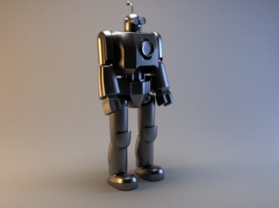
Preferred solution
Batch Computing
How would you guide ThoughtRender to load data so it can be processed by the rendering compute workload?
Typically the data should be loaded to a “fast” storage share (e.g., BeeGFS or Lustre Parallel File System)
For standard image processing, if they fit on the node’s local storage during processing, then SMB share can be used as source and destination

Slide 21
Preferred solution
Batch Computing
Will this data be stored on compute instances during a batch run? Would you store data on each compute node working in a batch, or would you store data in a shared area?
The answer depends on the workload
For compute rendering, it may be best to storage the data in a shared area (i.e., parallel filesystem or SMB storage share)
For image processing, data during a batch run may be OK to be stored on local SSD disk attached to the compute nodes -- used only for the duration of the batch workload

Slide 22
Preferred solution
Batch Computing
What sort of performance will be required from this storage?
It is a good idea to check/benchmark this against what the customer currently uses
The storage used should be able to "feed" all of the compute nodes for the duration of the run, such that the compute cores on the compute nodes are fully utilized

Slide 23
Preferred solution
Batch Computing
Will this data need to be backed up or archived?
Data during a compute run is typically referred to as "scratch" data, and may not be needed after the compute run, and can be discarded
Care should be taken that the output of the compute run is stored/saved elsewhere before the "scratch" storage used during the compute run is destroyed
Depending on the use case, it may be practical to "archive" all of the compute run data, including the interim data normally thrown away -- this may save time to recall later if a project needs to be re-done

Slide 24
Preferred solution
Operationalizing and Integrating
Can ThoughtRender connect their Batch Rendering workloads in Azure to their Rendering workloads on-premises?
Yes
Options include application-level connections (assuming a network connection such as VPN is already in place)
Check what type of HPC compute cluster that ThoughtRender uses on- premises, and check the scheduling and batch software they use on those systems
Some of this software (e.g., HPC Pack, IBM LSF, Slurm, Univa GridEngine) have integrations possible with Azure to allow “bursting” (i.e., keeping head node control on-premises, and sending compute jobs to compute nodes running on Azure – basically extending the on-premises HPC cluster into the cloud)

Slide 25

Preferred solution
Operationalizing and Integrating
Is it possible for ThoughtRender to keep their Azure infrastructure separate from their on-premises HPC clusters?
Yes
Separate clusters can be created in Azure, and configuration easily repeated or applied using Azure ARM templates, or using CycleCloud software

Slide 26
Preferred solution
Visualization and Remote Workstations
Are special types of compute instances needed for remote workstations in Azure?
Yes, the “NV” (NVIDIA Visualization) compute instances should be used
These contain special NVIDIA GRID technology graphics cards (e.g., NVIDIA M60), specialized for visualizations and remote workstation use

Slide 27
Preferred solution
Visualization and Remote Workstations
Is a special type of software required for client access? Could users simply use remote desktop? Would this perform the way ThoughtRender (or their customers) would like it to?
Typically, for “high end” workstation users, specialized software is needed for the best performing remote desktop technology
For example, “low latency” is must when interacting with 3D models in real-time
Partner solution software and technology in this space includes Teradici and Citrix HDX
These solutions are secure and can ensure color correctness
The idea to use specialized software (e.g., like Teradici or Citrix HDX) is typically driven by the need to perform and perform better than typical remote desktop
Not all specialized software may facilitate collaboration (i.e., multiple users sharing a screen), and not all software will provide the "low latency" needed to interact with the software in a performant way for the users involved

Slide 28
Preferred objections handling
Will Azure give us control to schedule jobs when we want?
Yes. With Azure Batch, jobs can be queued as normal, or sent to a queue and completed at desired times of day.
Will the capacity be available on Azure when we want it?
Typically, yes
This is the benefit of using a large public cloud provider with resources at scale
Need to consider default limits for specific resources in an Azure subscription and regional availability of specialized compute instances
We heard Microsoft does Linux now. But how true is this? Will it work with our chosen Linux version?
Yes, Microsoft loves Linux! Microsoft is committed to make Linux (and wider Open Source technologies) “a first class citizen” on Azure.
You can choose to run Azure Marketplace images of various Linux distributions/versions, and you can also BYOL (Bring Your Own License) for Enterprise Linux versions you own

Slide 29
Preferred objections handling
We have petabytes of data on-premises. It would cost us a fortune and take ages to move this to the cloud!
This can be a challenge
A dedicated connection to Azure via ExpressRoute may help
Alternately, consider optimized tools for transferring data. This includes Azcopy (an open source tool from Microsoft), or commercial tools such as Signiant, Aspera, or FileCatalyst With Azure Batch; jobs can be queued as normal, or sent to a queue and completed at desired times of the day.

Slide 30
Preferred objections handling
We heard collaboration is possible for 3D imaging workstations. But we have very specific color requirements and buy top-end workstation equipment for our users. Our users just wouldn't get the interaction performance they require with something "remote" in the cloud.
With specific software tools from our partners such as Teradici, specialized solutions exist for exactly this requirement.

Slide 31
Preferred objections handling
Will this take jobs away from our IT system administrators and HPC engineers?
No, IT system administrators can still maintain the systems in Azure, giving the users and the business insight via monitoring, logs, and can more easily respond to requests for new systems
HPC engineers can focus on taking advantage of the latest technologies in Azure to improve performance

Slide 32
Customer quote
“With Big Compute power via Azure at our fingertips, we are able to control our delivery – large or small, slow or fast – for our customers, as well as allowing our own team to collaborate and share better, focusing less on fixing hardware, and more on thinking and rendering!”
- Thomas Pix, CIO of ThoughtRender

